Slide 1
Big Data Architecture and Governance
Group Project | COVID 19 Infection Data
Navaneeta Naik | Nikunj Doshi | Yu Ren

Slide 2
Project Details

Slide 3

Team members
Nikunj Doshi : Project Manager
Yu Ren:
Data Engineer
Navaneeta Naik:
QA & Data Analyst
KH :
End/ business User
Vividha Singh :
Sponsor

Slide 4

PROJECT PLAN
Our aim was to analyze and figure out the impact of Covid Cases in the different parts of the globe and how death cases and confirmed cases factored in driving of Covid cases.
How many Deaths occurred after Confirmed Cases?
Which countries showed highest Recovery?
Was there any country who did not had any deaths after confirmed case?
With the help of this data set we would love to see more conclusions drawn so that with the help of our analysis, Business users like research scientists and Pharma Companies for creating vaccines,
Also End Users like people all over the globe and Government Agencies who could draw some insights which may help them to improve their plans and guidelines.

Slide 5






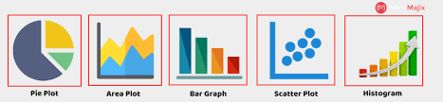
Tools & Techniques Used

Slide 6
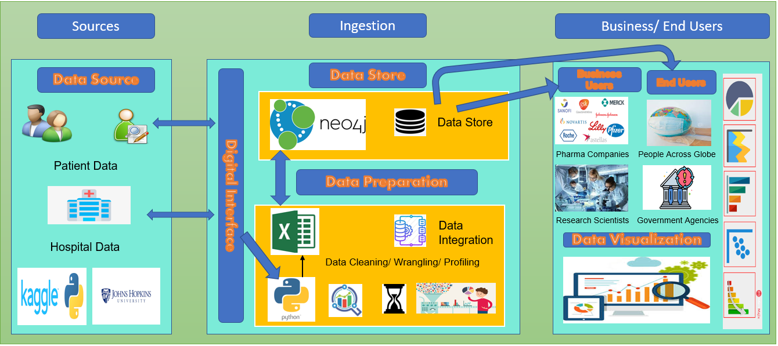
Vision Diagram

Slide 7




Business / End Users
Business Users
End Users
Pharma
Companies
People Across Globe
Research
Scientists
Government Agencies

Slide 8
Data Pre Processing

Slide 9
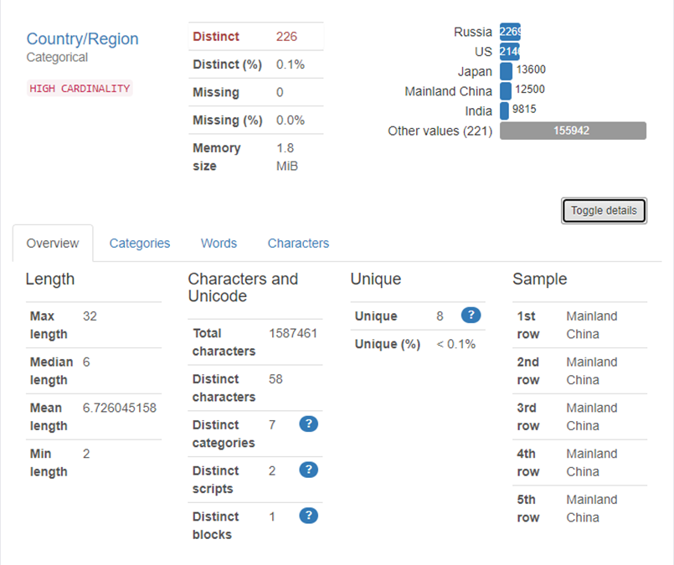
Data Profiling - Python
Data Profiling provides summarized information about our dataset
Provides information about each column- Missing values, Duplicates, Zeros and Unique columns
The profiling provided information about the missing values in our dataset.

Slide 10
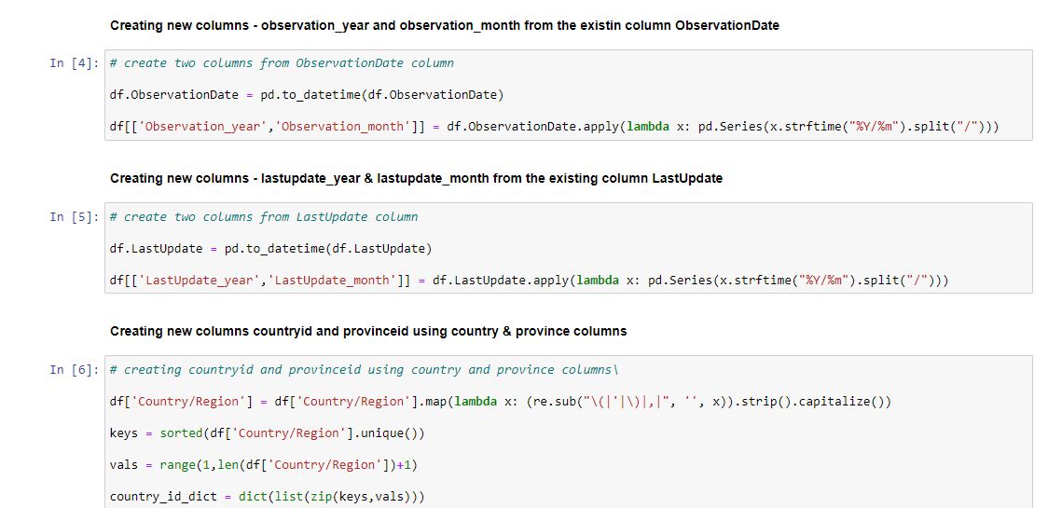
Data Wrangling - Python
Data wrangling is the process of transforming data to make it more appropriate and valuable to be used in analytics
For analytics purpose, we created new columns Observation_month & Observation_year from ObservationDate and created LastUpdate_month & LastUpdate_year from LastUpdate
Two additional columns were created ProvinceID, Country_Id to identify distinct countries and provinces within those countries

Slide 11
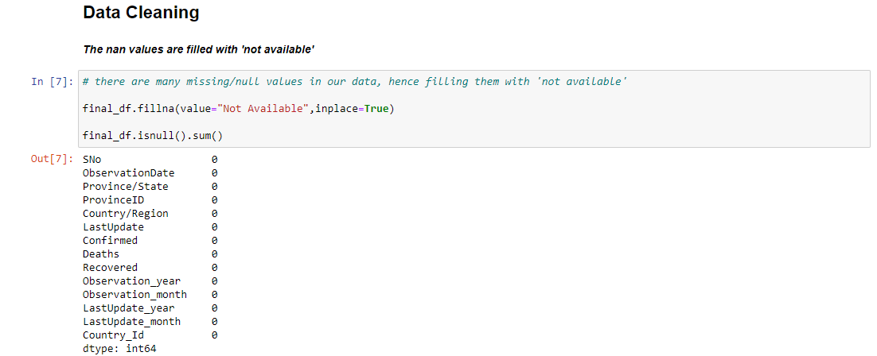
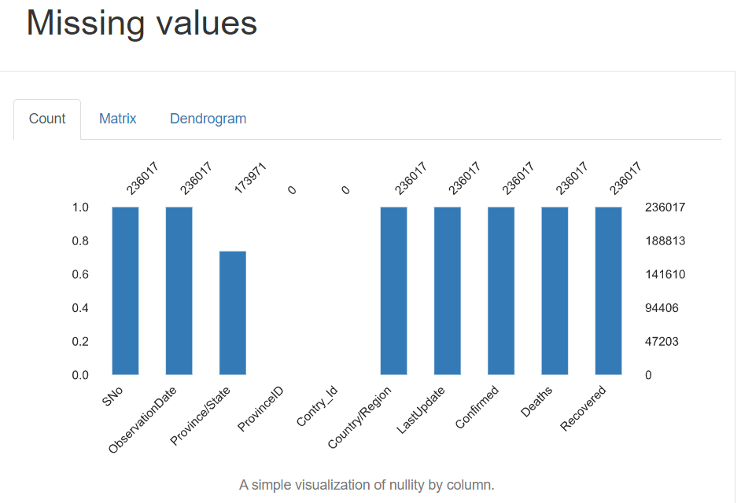
Data Cleaning
There were missing values in the column State/Province
Replaced null values in State/Province with ‘not available’

Slide 12
Data Loading – Neo 4J

Slide 13
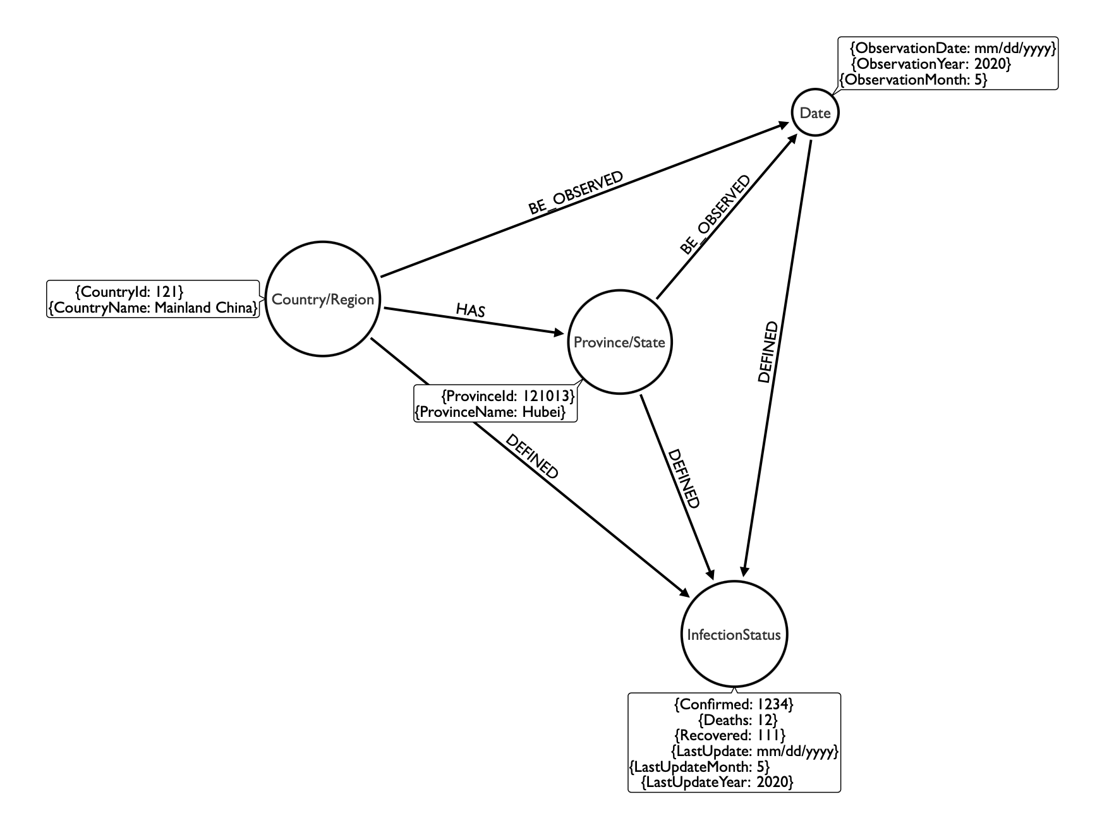
NEO4J – Data Modal

Slide 14
NEO4J Screenshot - Create Constraints
Create Contraints: country(CountryId), province (ProvinceId), date(ObservationDate), infectionStatus(EntryId)

Slide 15
NEO4J Screenshot - Create Nodes

Slide 16
NEO4J Screenshot - Create Relationships

Slide 17
NEO4J Screenshot - Nodes

Slide 18
NEO4J Screenshot - Relationships

Slide 19
NEO4J Screenshot - Relationships

Slide 20
TECHNICAL METADATA

Slide 21
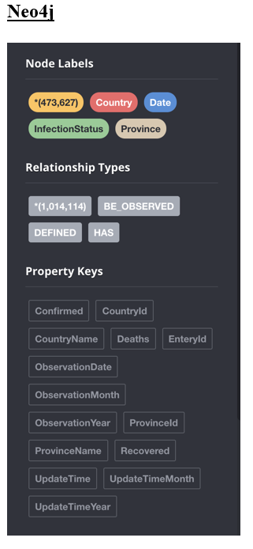
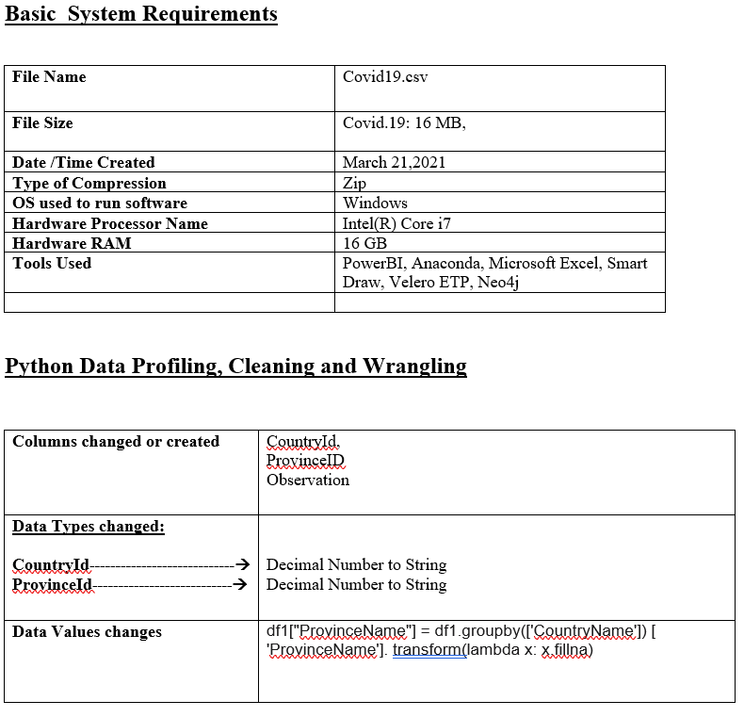
Technical Metadata

Slide 22
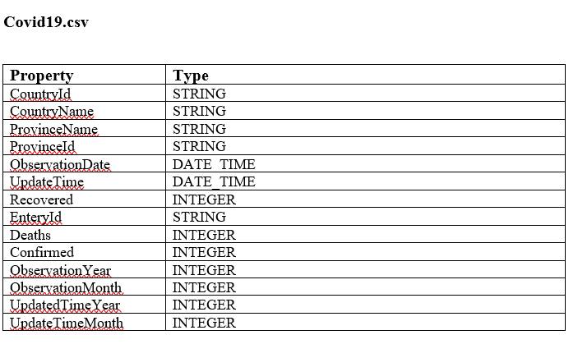
Technical Metadata

Slide 23
BUSINESS METADATA

Slide 24
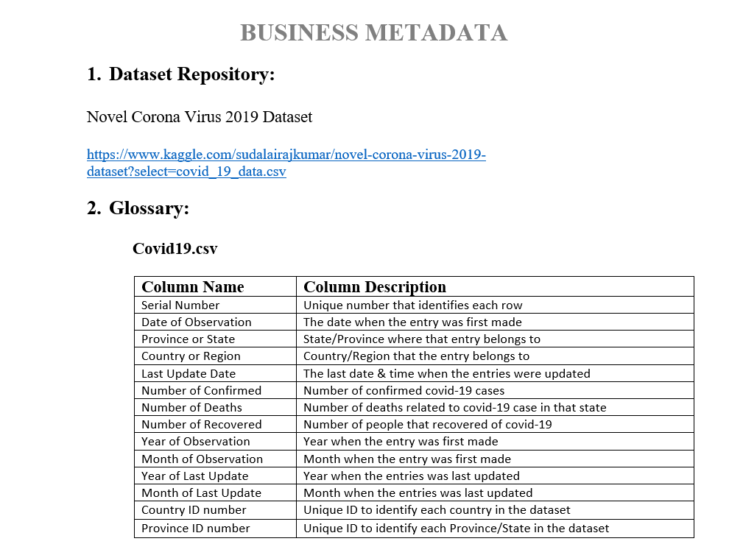
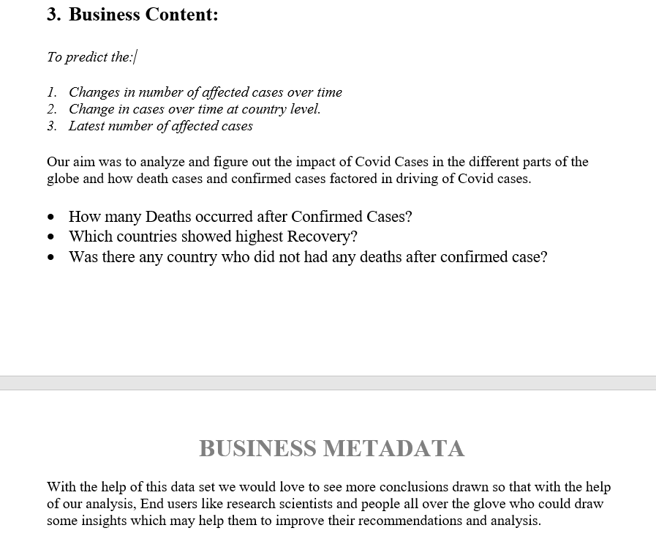
Business Metadata

Slide 25
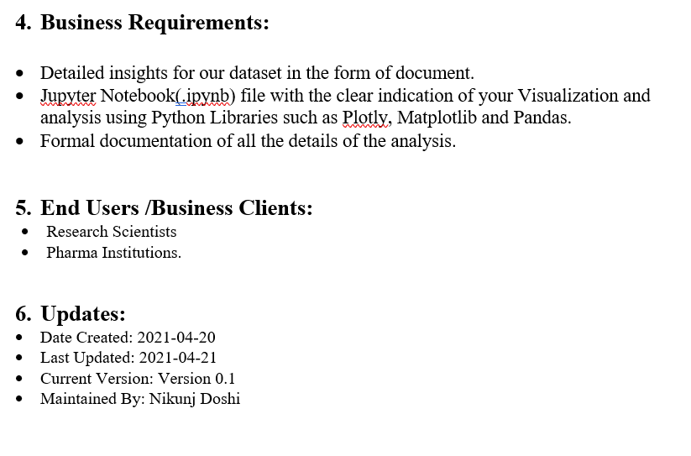
Business Metadata

Slide 26
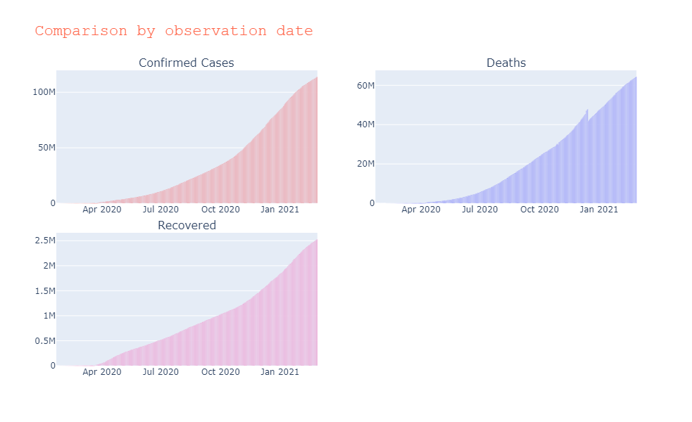
Data Visualizations - Python
Data Visualization is the graphic representation of data that helps understand the data without requiring technical knowledge
Data validation & Data visualization were performed using Python
What was the difference between the confirmed, recovered and death numbers for different month & year?
What was the country that had highest number of deaths?
What was the country that had highest number of recovered patients?
What was the country that had highest number of confirmed cases?
Which State had highest number of deaths?
What was the difference between the confirmed, recovered and death numbers for different countries?
What was the difference in number of deaths in year 2020 and year 2021?
What was the difference in number of patients that recovered from covid in the year 2020 and year 2021?

Slide 27
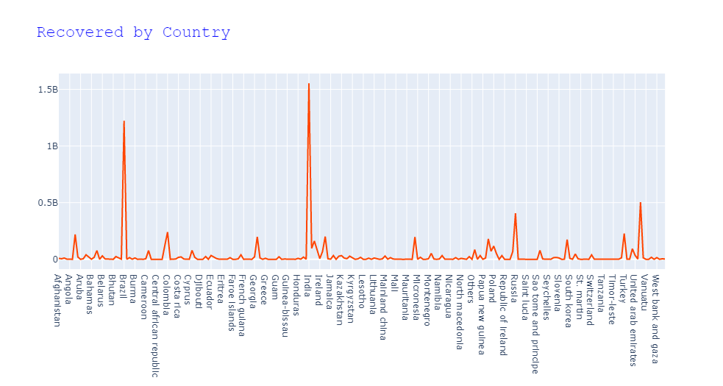
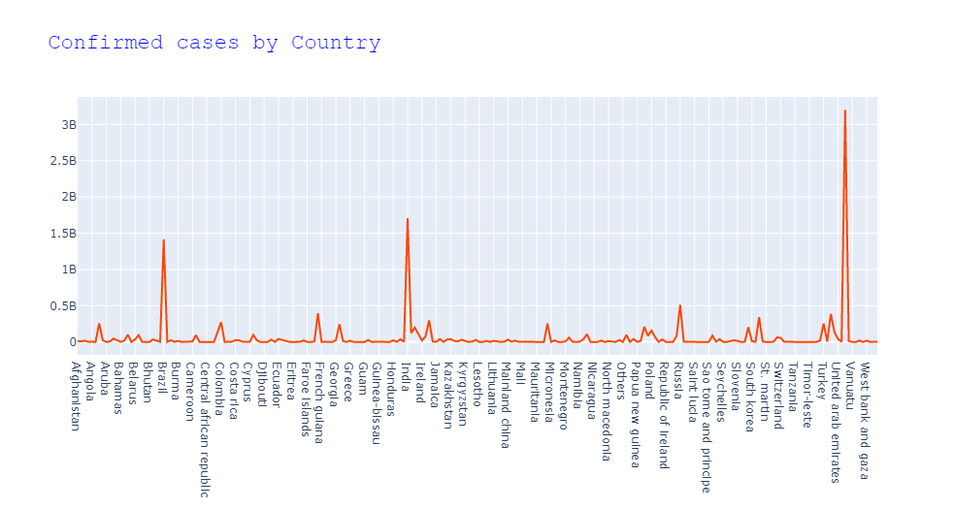
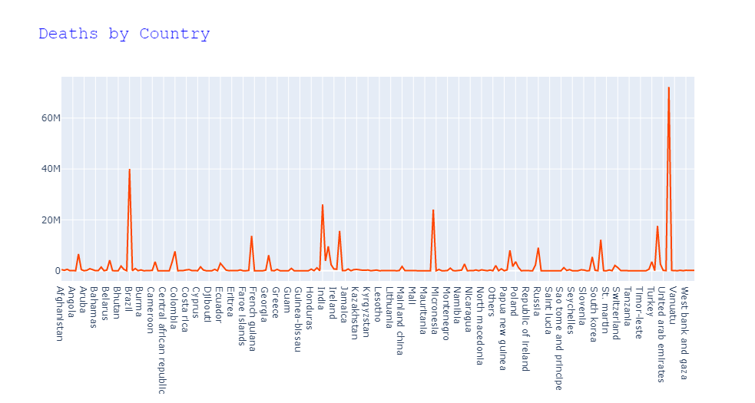
Visualizations

Slide 28
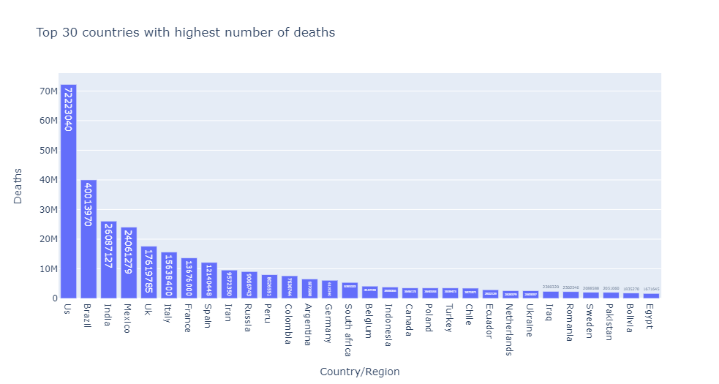
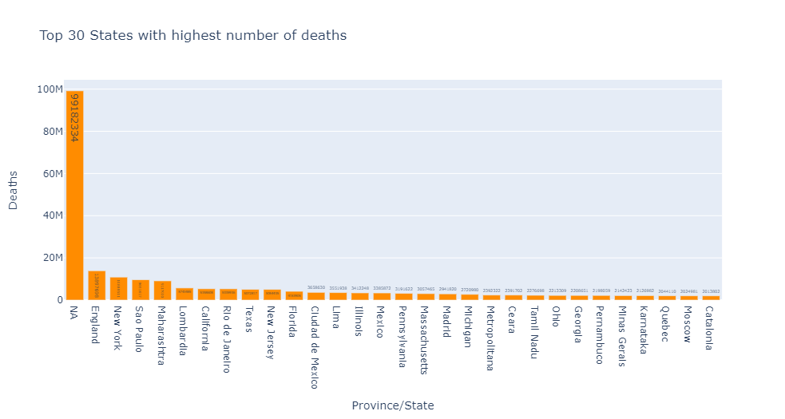
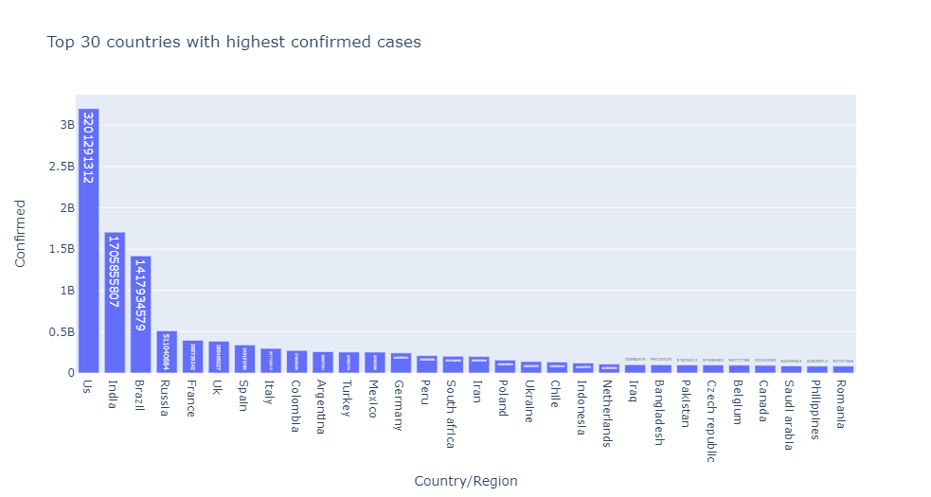
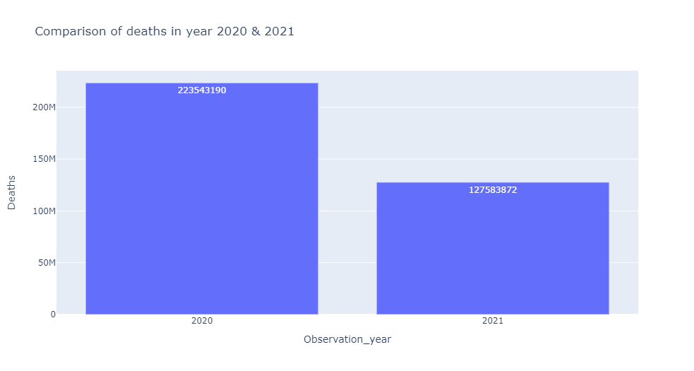
Visualizations

Slide 29
Challenges

Slide 30
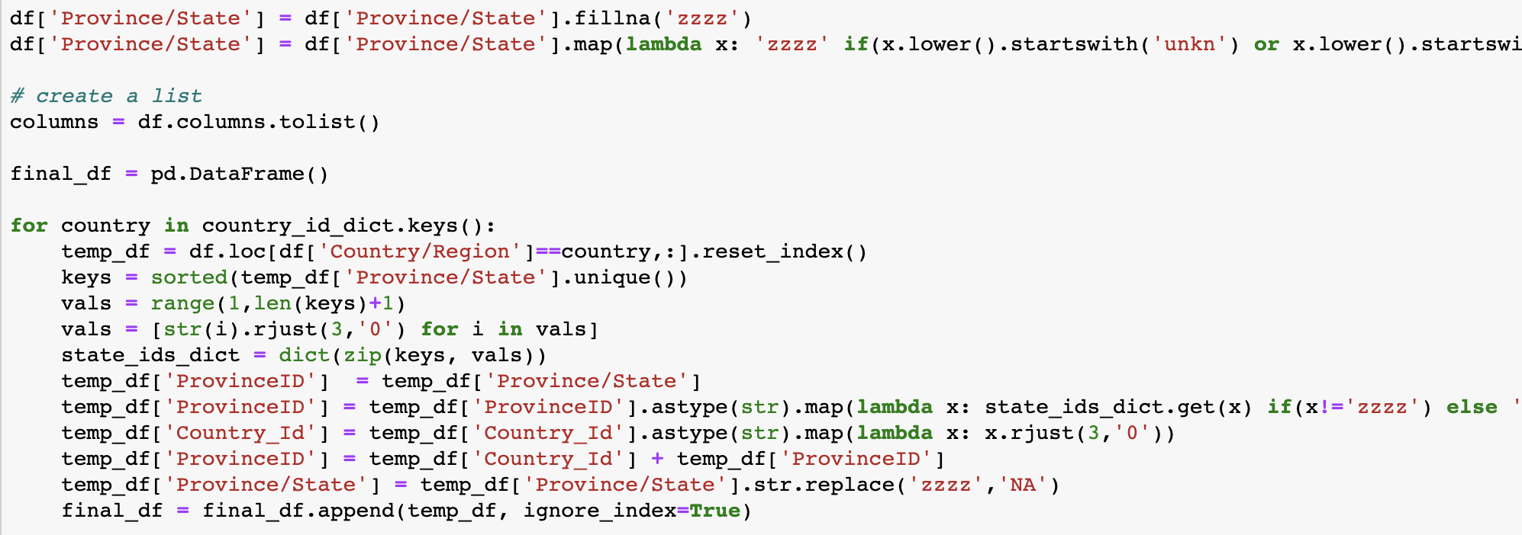
Challenges
Challenge 1: To generate the unique Province Id
Resolution 1:

Slide 31
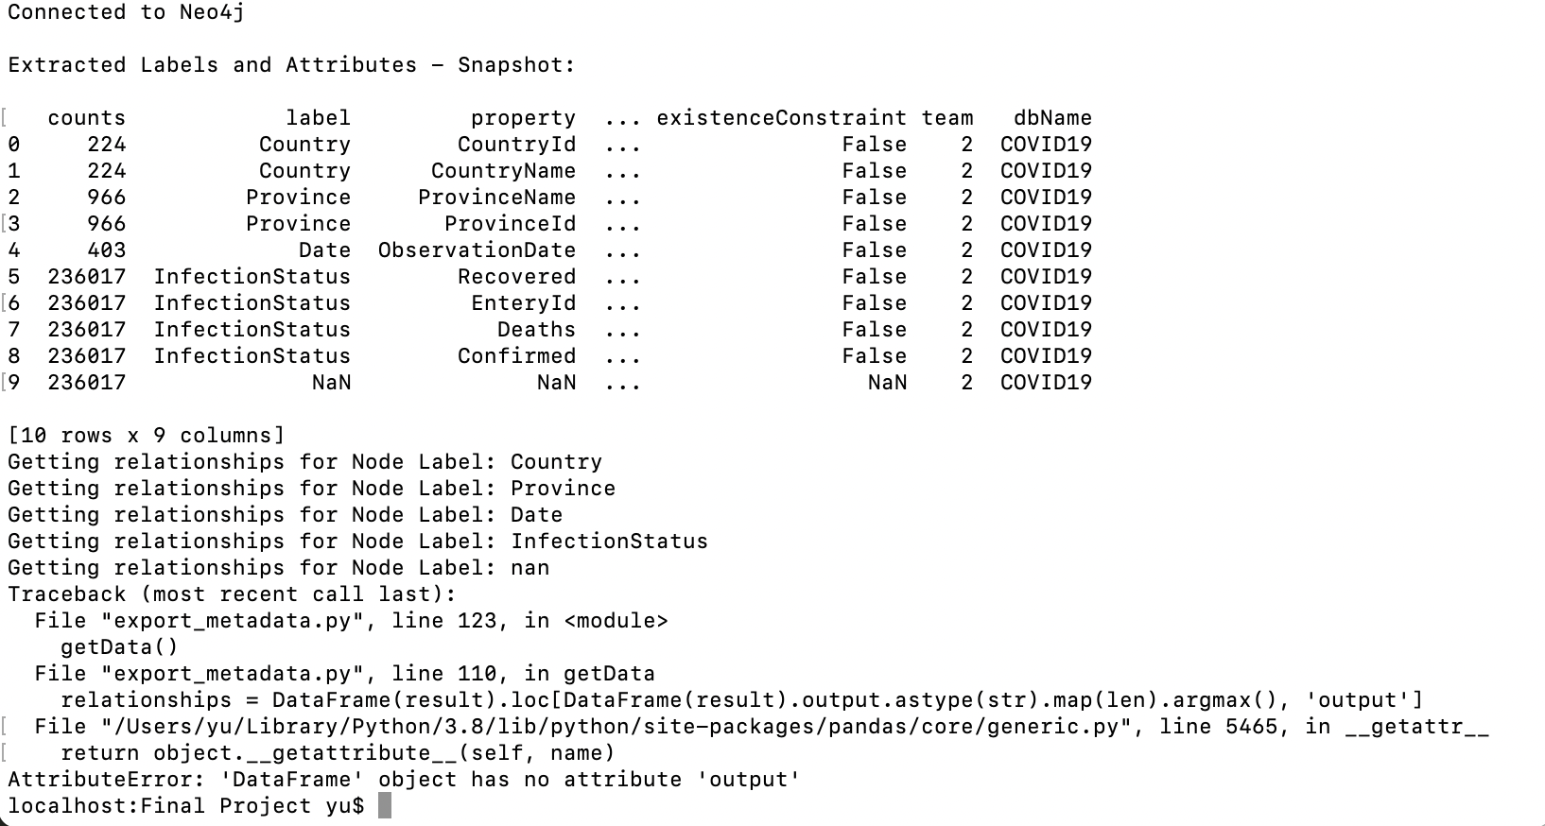
Challenges
Challenge 2: There are some issues when exporting metadata to google excel

Slide 32
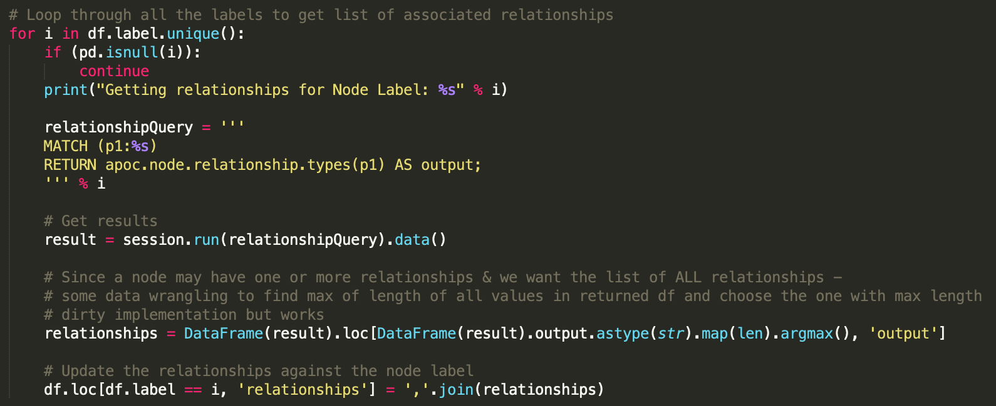
Resolution 2: Filter the abnormal data:

Slide 33
Velero Screenshots

Slide 34
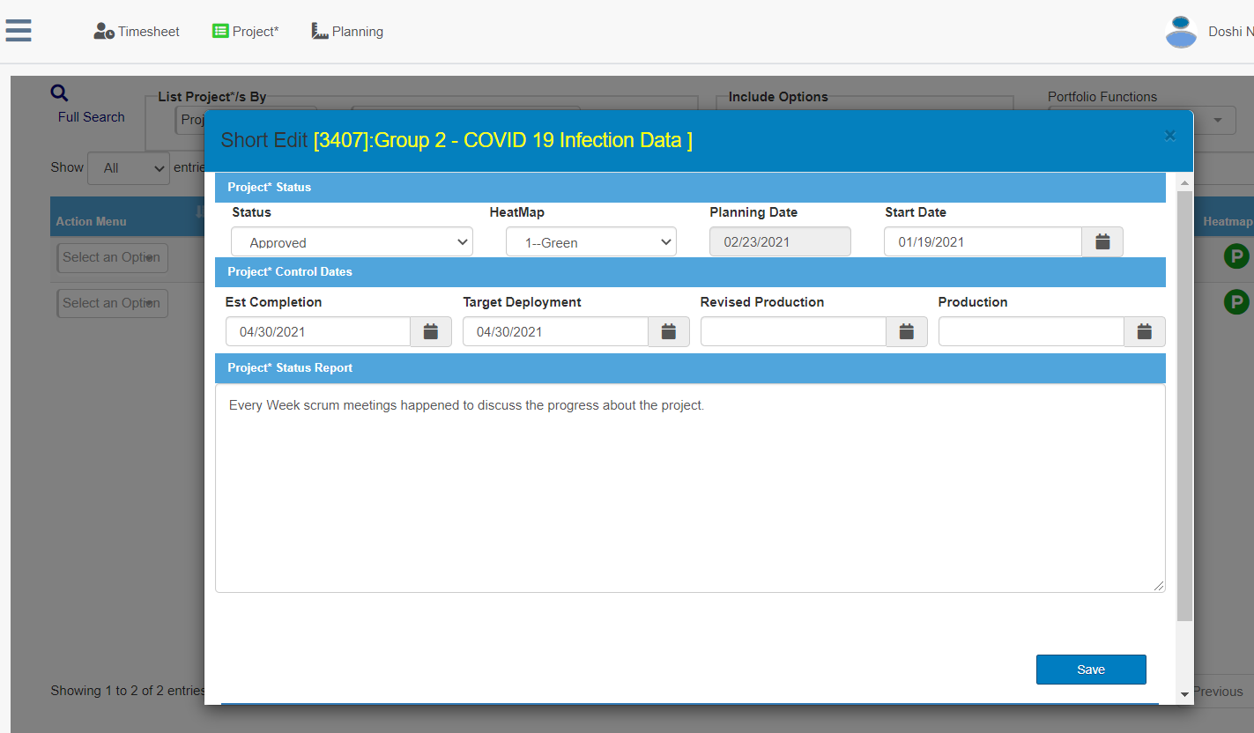
Velero Screenshot - Short Form

Slide 35
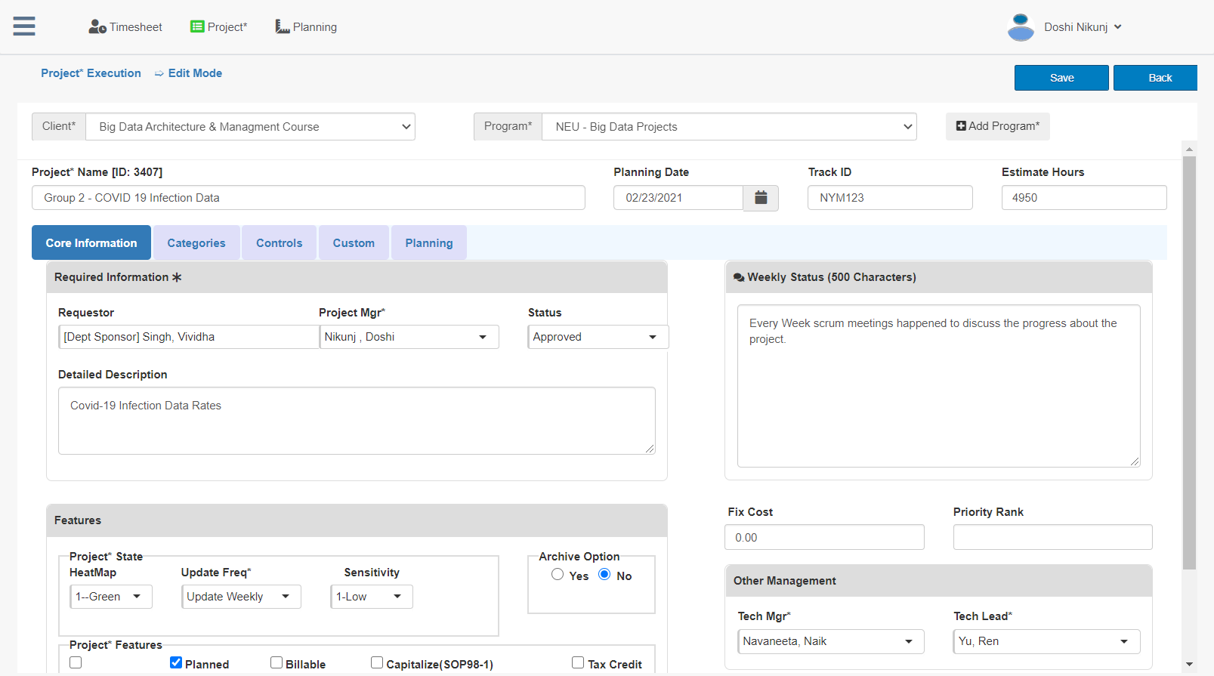
Velero Screenshot – Long Form

Slide 36
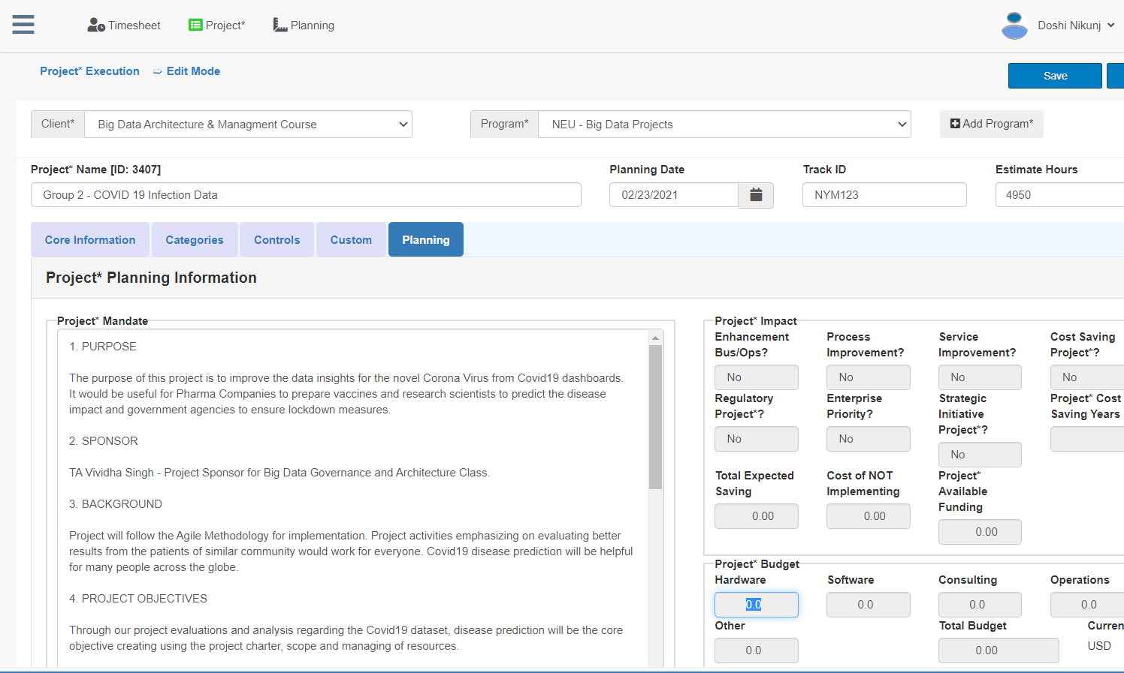
Velero Screenshot - Mandate

Slide 37
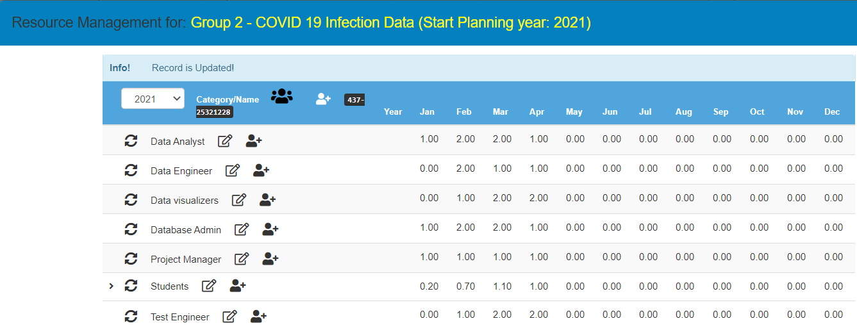
Velero Screenshot – Resource Management

Slide 38
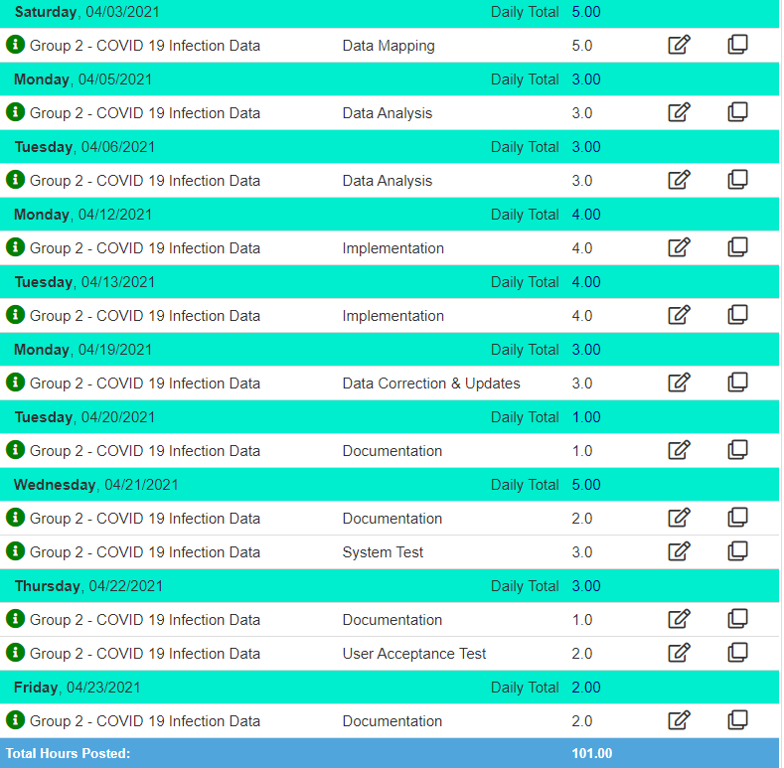
Velero Screenshot – Time Sheet

Slide 39
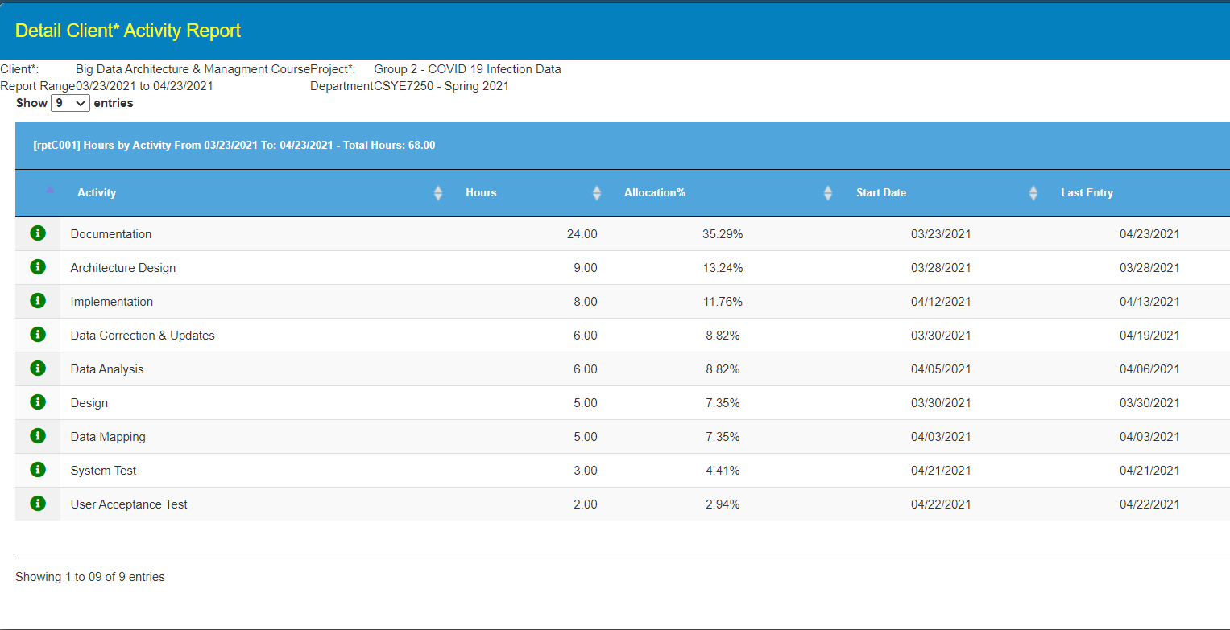
Velero Screenshot - Activity Allocation

Slide 40
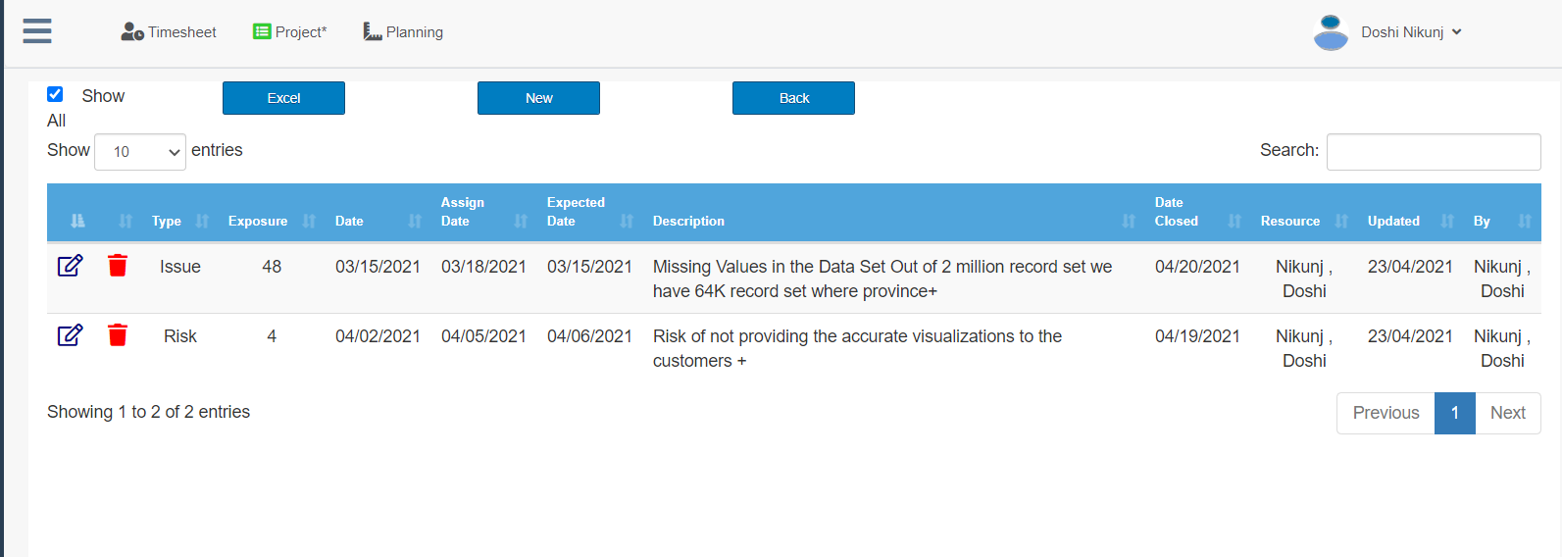
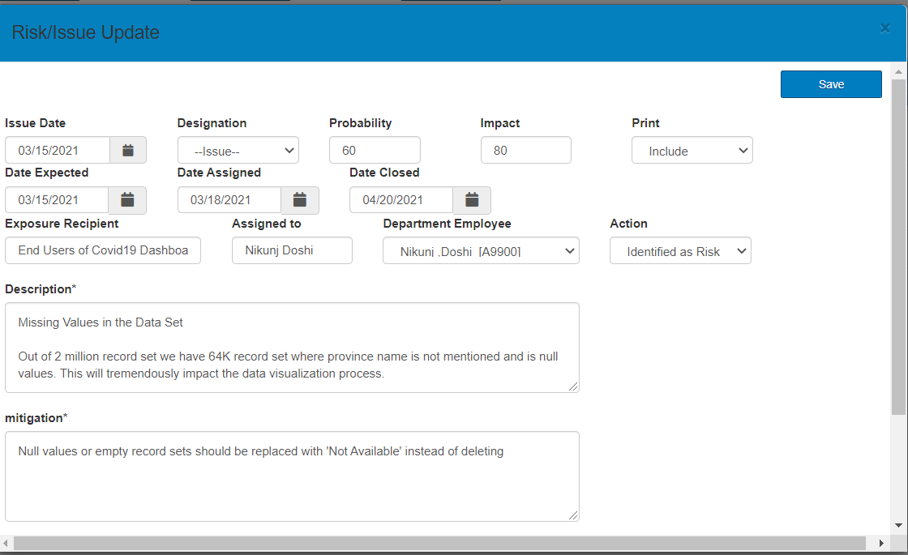
Velero Screenshot - Risks & Issues

Slide 41
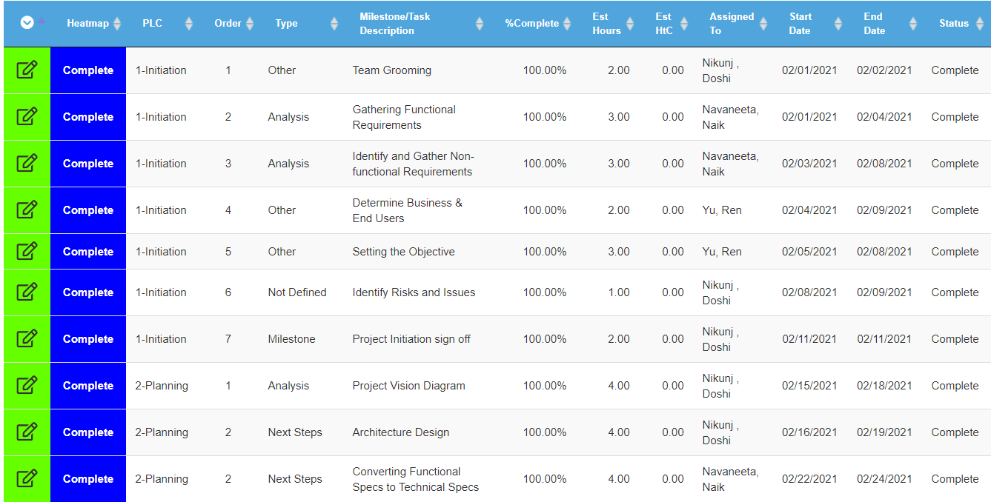
Velero Screenshot – Group Allocation 1

Slide 42
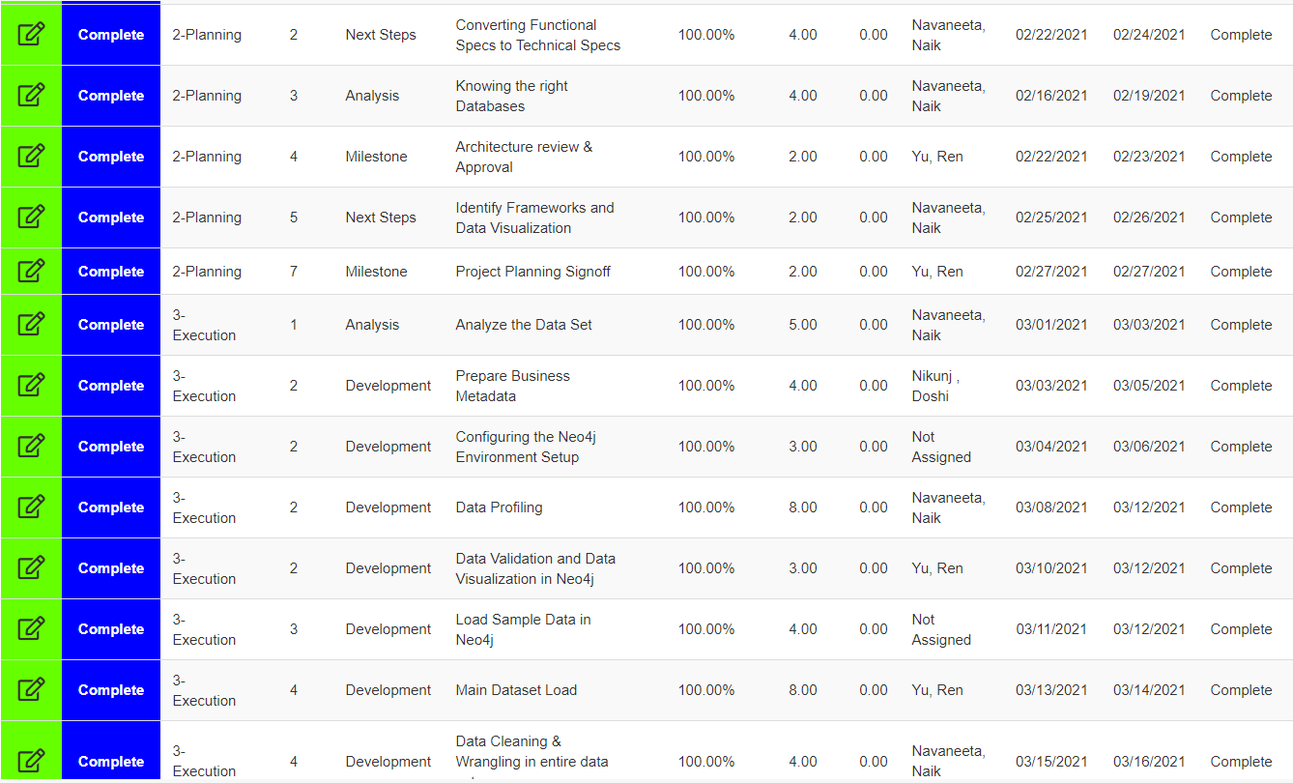
Velero Screenshot – Group Allocation 2

Slide 43
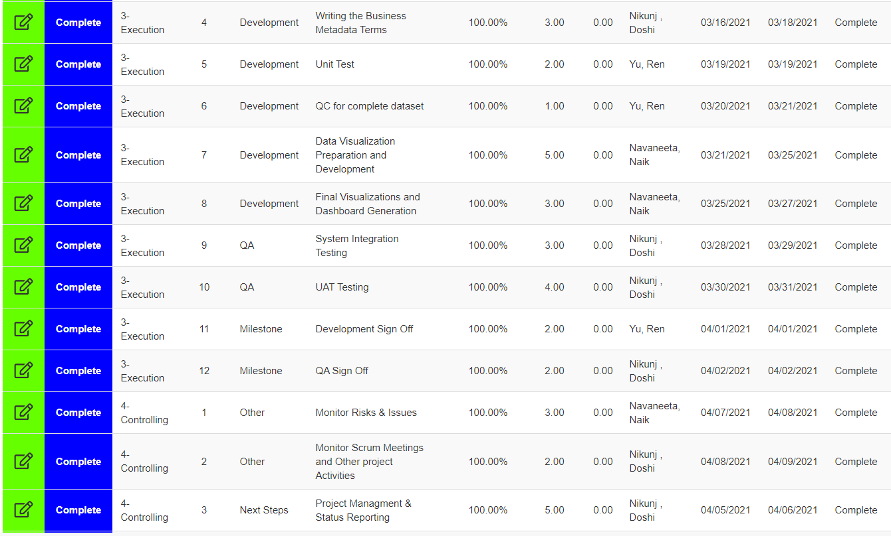
Velero Screenshot - Group Allocation 3

Slide 44
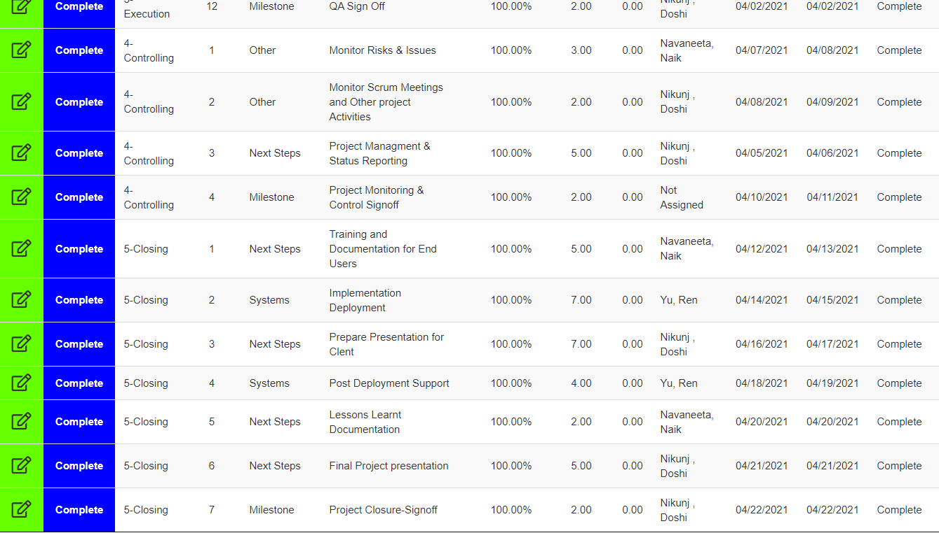
Velero Screenshot – Group Allocation 4

Slide 45
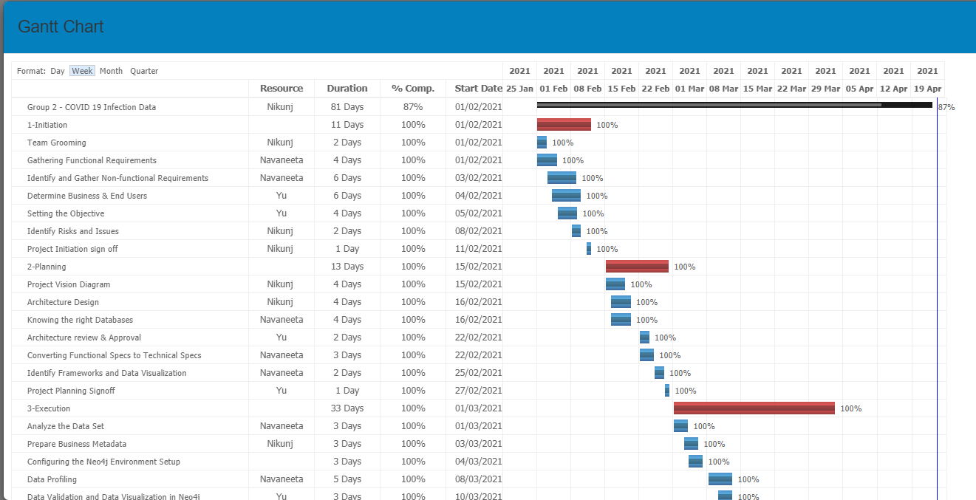
Velero Screenshot - Gantt Chart 1

Slide 46
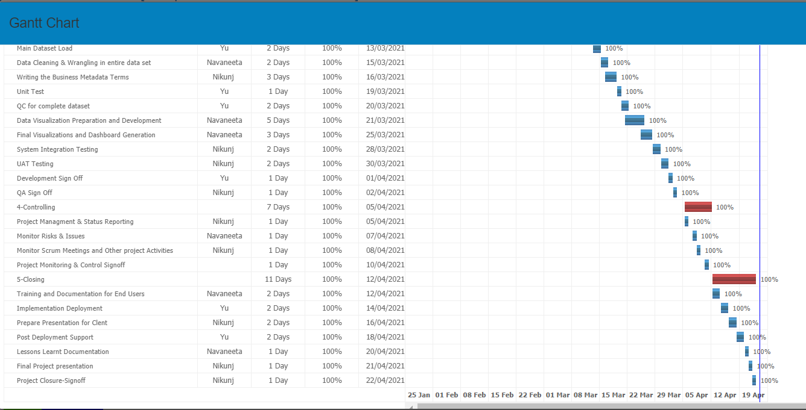
Velero Screenshot - Gantt Chart 2

Slide 47
Q/a – Test cases

Slide 48
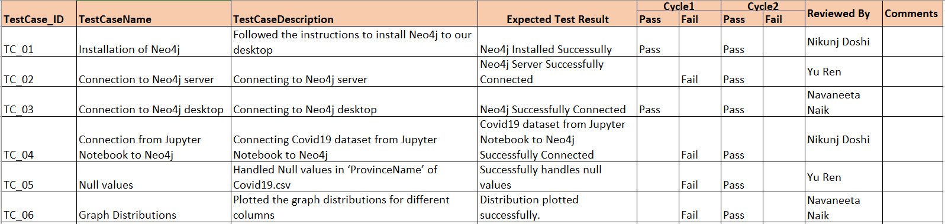
Unit Test Cases - Neo4j

Slide 49
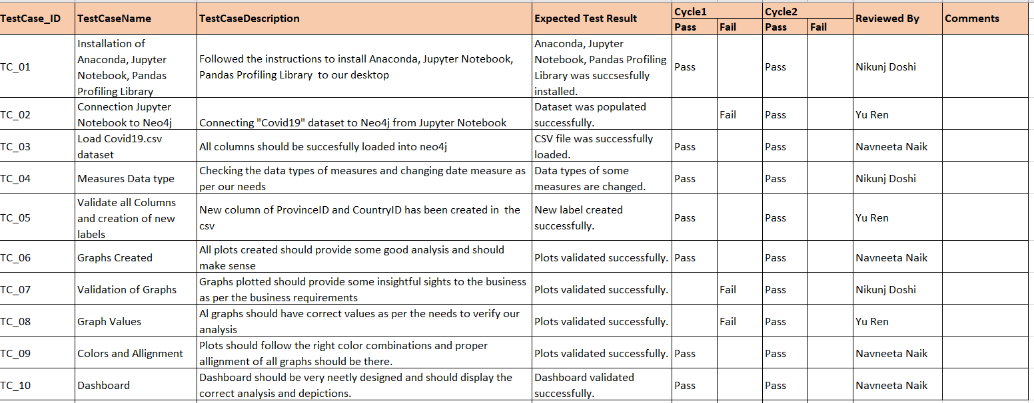
System and Integration Testing

Slide 50
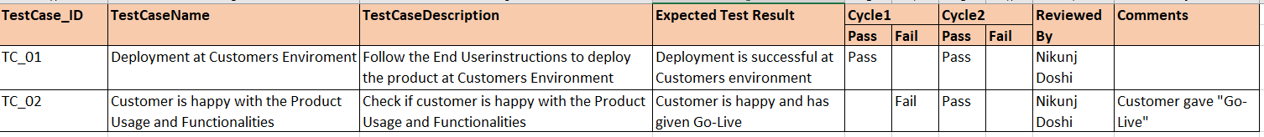
User Acceptance Testing

Slide 51
Thank You

